Slide 1
Construct Validity: A Contemporary Discussion
By: Sean Duan

Slide 2
What is a Construct?
Psychological process or characteristic believed to account for individual or group differences in behavior.¹
E.g., Depression, Anxiety, Intelligence, etc.
How do we measure these ‘invisible characteristics’?
Strauss, M. E., & Smith, G. T. (2009). Construct validity: Advances in theory and methodology. Annual review of clinical psychology, 5, 1-25.

Slide 3
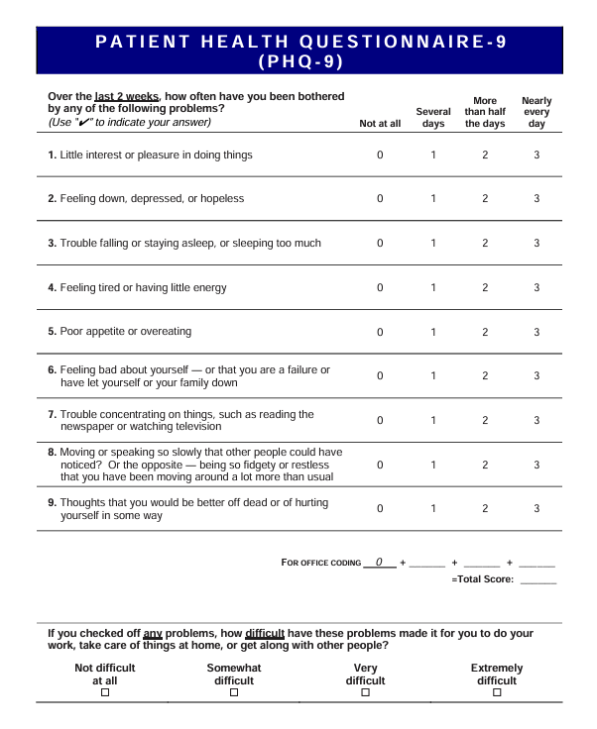
Depression – Patient Health Questionnaire 9 (PHQ-9)¹
10 – item scale based off the 9 DSM-IV criteria for depression
Items range from 0 (not at all) to 3 (nearly every day).
Scored as an average.
Kroenke, K., Spitzer, R.L. and Williams, J.B.W. (2001), The PHQ-9. Journal of General Internal Medicine, 16: 606-613. https://doi.org/10.1046/j.1525-1497.2001.016009606.x

Slide 4
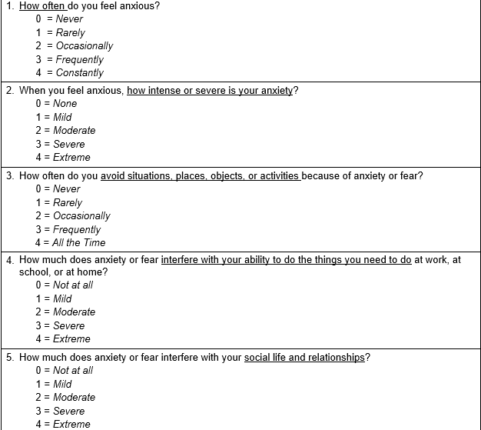
Anxiety – Overall Anxiety Severity and Impairment Scale (OASIS)¹
5 – Item self report measure
Range from 0 (Never/None/Not at All) to 4 (Constantly/Extreme/All the time).
Scored as a sum
Campbell-Sills, L., Norman, S. B., Craske, M. G., Sullivan, G., Lang, A. J., Chavira, D. A., ... & Stein, M. B. (2009). Validation of a brief measure of anxiety-related severity and impairment: the Overall Anxiety Severity and Impairment Scale (OASIS). Journal of affective disorders, 112(1-3), 92-101.

Slide 5
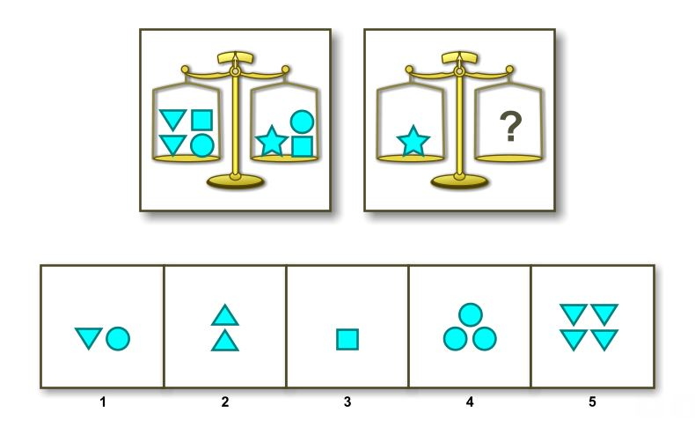
Intelligence – Wechsler Adult Intelligence Scale (WAIS)¹
14 subtests (e.g., Vocabulary, Similarities, Comprehension, etc.)
Scored from 45 to 155, mean of 100 and SD of 15
Kroenke, K., Spitzer, R.L. and Williams, J.B.W. (2001), The PHQ-9. Journal of General Internal Medicine, 16: 606-613. https://doi.org/10.1046/j.1525-1497.2001.016009606.x

Slide 6
What is Construct Validity?¹
Evaluation of the extent to which a measure assess the construct it is deemed to measure
Comprehensive – contains all sources of evidence supporting specific interpretations of a score from a measure AND actions based on those interpretations
Strauss, M. E., & Smith, G. T. (2009). Construct validity: Advances in theory and methodology. Annual review of clinical psychology, 5, 1-25.

Slide 7
How to Measure Construct Validity?¹
Validate measures by testing if they relate to measures of other constructs (based on theory)
Construct validity is both measure and theory validation!
Construct validity is not binary, but a continuum. Accumulation of evidence over time increases relative construct validity.
Strauss, M. E., & Smith, G. T. (2009). Construct validity: Advances in theory and methodology. Annual review of clinical psychology, 5, 1-25.

Slide 8
How to Measure Construct Validity?¹
R_{alerting-CV} : Correlation between the pattern of correlations predicted between the measure being validated and the pattern of correlations actually obtained.
E.g., in a measure of intelligence, assumed to correlate to verbal IQ as .5, nonverbal skill .4, and MMPI-2 at -.1 .Correlate these predicted values with the obtained values. Ranges from -1 to 1
As more variables are added, becomes more informative
Westen, Drew; Rosenthal, Robert (2003). Quantifying construct validity: Two simple measures.. Journal of Personality and Social Psychology, 84(3), 608–618. doi:10.1037/0022-3514.84.3.608

Slide 9
How to Measure Construct Validity?¹
R_{alerting-CV} : Correlation between the pattern of correlations predicted between the measure being validated and the pattern of correlations actually obtained.
E.g., in a measure of intelligence, assumed to correlate to verbal IQ as .5, nonverbal skill .4, and MMPI-2 at -.1 .Correlate these predicted values with the obtained values. Ranges from -1 to 1
As more variables are added, becomes more informative
Westen, Drew; Rosenthal, Robert (2003). Quantifying construct validity: Two simple measures.. Journal of Personality and Social Psychology, 84(3), 608–618. doi:10.1037/0022-3514.84.3.608

Slide 10
Convergent Validity¹
Convergent validity is a form of construct validity when using two different measurement procedures/methods to collect data about the same construct (e.g., depression)
E.g., Self-Reported sleep quality survey, and video-observation of actual sleep performance.
If the two scores calculated converge, this is evidence that the same construct is being measured in both cases.
Abma IL, Rovers M, van der Wees PJ. Appraising convergent validity of patient-reported outcome measures in systematic reviews: constructing hypotheses and interpreting outcomes. BMC Res Notes. 2016 Apr 19;9:226. doi: 10.1186/s13104-016-2034-2. PMID: 27094345; PMCID: PMC4837507.

Slide 11
Divergent Validity¹
Divergent validity is a form of construct validity, that demonstrates the construct you are examining (e.g., anger) is different from other constructs (e.g., depression).
E.g., measurement of anger is not (or weakly) correlated with confounding factors (depression).
If the two scores diverge, that is evidence that you are in fact measuring theoretically distinct concepts.
Rönkkö, M., & Cho, E. (2022). An Updated Guideline for Assessing Discriminant Validity. Organizational Research Methods, 25(1), 6-14. https://doi.org/10.1177/1094428120968614

Slide 12
What is NOT Construct Validity?¹
‘Face Validity’: Measures and findings that ‘look and feel right’ on the surface.
E.g., Observations that appear to be true within our understanding can claim to possess ‘face validity’
Still commonly used in many fields of research!
E.g., Training robots, laparoscopic troubleshooting, moral conviction
Mosier, C. I. (1947). A critical examination of the concepts of face validity. Educational and Psychological Measurement, 7(2), 191-205.

Slide 13
Laparoscopic Surgery – Team Training Performance Module¹
4 scenarios, 9 – item scoring, pass/fail based on ‘correct’ physician troubleshooting choices.
Face validity - “The extent to which this simulation exercise was a good method for learning/assessing teamwork skills”
Assessed by exercise participants rating perceived realism and educational benefit.
Nabeel A. Arain; Deborah C. Hogg; Rajiv B. Gala; Ravi Bhoja; Seifu T. Tesfay; Erin M. Webb; Daniel J. Scott (2012). Construct and face validity of the American College of Surgeons/Association of Program Directors in Surgery laparoscopic troubleshooting team training exercise. , 203(1), 0–62. doi:10.1016/j.amjsurg.2011.08.010

Slide 14
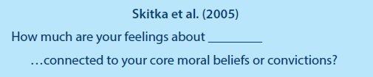
Moral Conviction – Single Item Moral Conviction Screener¹
Single item scored on a 5-point likert scale (1 = not at all, 5 = very much)
Face validity – Due to belief that individuals can recognize ‘what is or is not moral’, without need for a clear definition of such
Skitka, L. J., Bauman, C. W., & Sargis, E. G. (2005). Moral Conviction: Another Contributor to Attitude Strength or Something More? Journal of Personality and Social Psychology, 88(6), 895–917. https://doi.org/10.1037/0022-3514.88.6.895

Slide 15
How Does This Work in Practice?¹
Measurements of Moral Conviction are wildly disparate.
Several experiments attempting to manipulate moral conviction were not successful – likely in part to poor psychometric performance of the scale measuring the construct
Thus – To address these issues, we need to ensure that we are using a measure with construct validity.
Mosier, C. I. (1947). A critical examination of the concepts of face validity. Educational and Psychological Measurement, 7(2), 191-205.

Slide 16
How Does This Work in Practice?¹
We want to manipulate the construct of ‘Moral Conviction’
This has not been always successful, likely in part to poor psychometric performance of the scales.
Additionally, measures of ‘Moral Conviction’ often define it differently, often in substantive ways
To ensure successful manipulation, we must first ensure that we have construct validity for our measure!
Skitka, L. J., Hanson, B. E., Morgan, G. S., & Wisneski, D. C. (2021). The psychology of moral conviction. Annual Review of Psychology, 72, 347-366.

Slide 17
Measures of Moral Conviction
Definition | Example Item
A strong and absolute belief that something is right or wrong, moral or immoral. These beliefs are inherently motivation and highly emotionally charged. Morally convicted beliefs are perceived as a universal and objective truth. | My attitude about ____ is… •A reflection of my core moral beliefs and convictions. •Connected to fundamental beliefs about right and wrong. •A moral stance. •Based on moral principles.
Strong attitudes regarding specific issues, framed as “oughts” and “shoulds”. Treating specific norms as absolutes and motivating behavior at the expense of all else, including personal gain. | •“____ bothers me a lot” •“____ threatens values that are important to me” •“My attitude towards ____ is a matter of principle”
Rules or beliefs about what is appropriate surrounding social issues ‘deeply embedded into society (e.g., do not steal)’. | To what extent do you feel your position on ___ is … •Based on strong personal principles? •Morally correct? •A moral stance?
Lay understanding of the participants of a given topic as moral or non-moral, bypassing assumptions from the researchers about the nature of moral vs. nonmoral evaluation. | •“I have the idea that there is a clear-cut distinction between moral and immoral when ____ is concerned.” •“When ____ is concerned, rules regarding what is moral and what is immoral apply to everyone.”

Slide 18
Measures of Moral Conviction
Many of these measures rely explicitly on the ‘face validity’ of measurements of moral conviction itself
An entire category of definition actively refuses to clearly define what ‘moral conviction’ even is, relying on the lay perception of participants to determine for themselves what is meant.
Thus, we would like to try to assess Convergent validity and Divergent validity to assess Construct validity directly.

Slide 19
Moral Conviction – Example Items
Is ___ moral or nonmoral, depending on what you believe, regardless of how the issue may be viewed by others?
My attitude about ___ is …
A reflection of my core moral beliefs and convictions.
Connected to fundamental beliefs about right and wrong.
A moral stance.
Based on moral principles.

Slide 20
Moral Conviction – Example Items cont.
How morally wrong/right would it be for you to ___?
There are very important ethical aspects to this situation
This matter clearly does not involve ethics or moral issues
This situation could be described as a moral issue

Slide 21
Moral Conviction – Convergent Validity
Brief choice vignettes directly relating to hypothetical moral decisions associated with each issue.
????

Slide 22
Moral Conviction – Divergent Validity
Assessment of other unrelated constructs
Attitude importance
Attitude certainty
????

Slide 23


My sincerest gratitude for my extremely sage advisor:
Victoria Shaffer
Finally: All of you for coming and listening to my presentation!

